Slide 1
Fresh Grads – Group Project
Online Courier Management Application

Slide 2
Problem Statement
To Create an Online Application for Courier Management System.
CourierOffice Outlet Module would maintain all the information related to the courier office outlets across various cities.
Shipment module would take care of all the shipment operations like initiating transaction, checking the status, closing or rejecting the transaction.
Manager should be able to add OfficeStaff members, remove OfficeStaff members, monitor the overall couriers status and get the various reports like delivered couriers and should be able to fetch all the registered complaints.
Payment Service would offer facility of payment either by cash or any of the cards (debit/credit)
Customers or End Users should be able to avail the online courier service, track/monitor the status of their courier, and report complaints if any.

Slide 3
Road Map
Application will be developed in following Sprints –
Core Java +JPA with Hibernate
Spring Boot + Rest Controller + JPA with Hibernate
Angular for UI design (Front End) + Integration with previous Sprint

Slide 4
Plan
Design
Generate the skeleton as per class design provided
TDD approach
Identify test cases for each module
Write Failing Test cases
Convert the Test Cases in GREEN
Implement the case study in incremental manner

Slide 5
Modules
Office Module
Shipment /Delivery Module
Payment Module
Manager Module
Customer Module

Slide 6
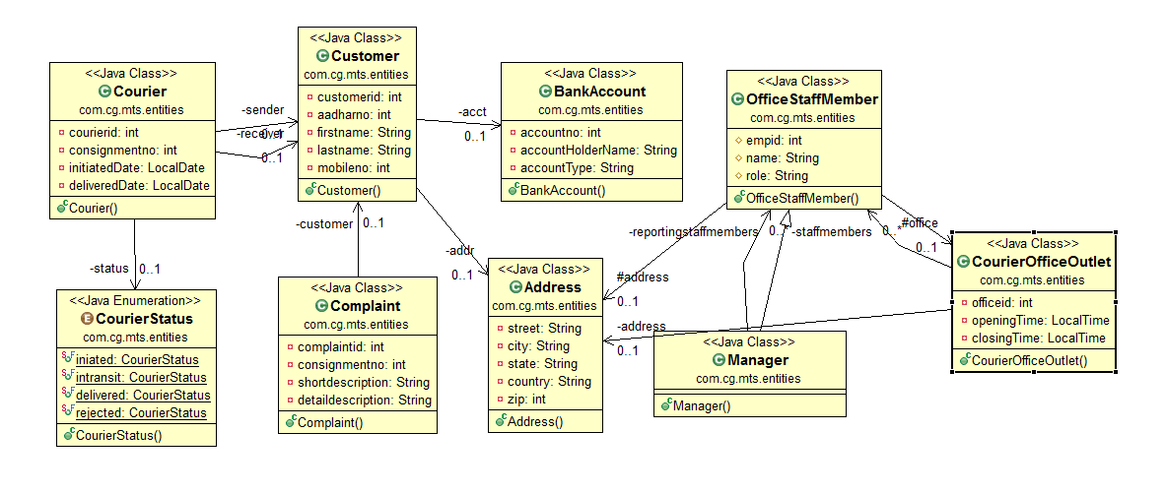
Class Design
POJO Classes:

Slide 7
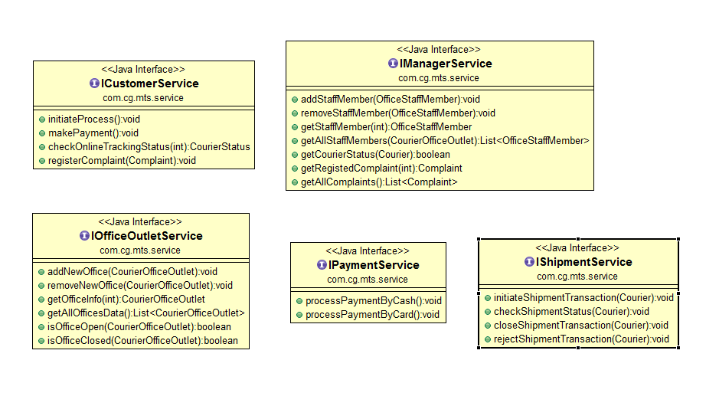
Class Design
Service Interface:

Slide 8
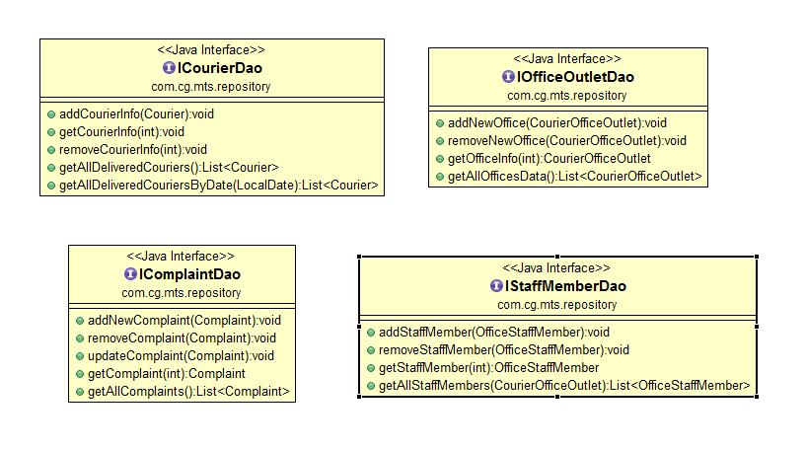
Class Design
Repository:

Slide 9




Questions

